Slide 1
Listening and integrated skills A2
Instructor: Nguyen Ha Phuong

Slide 2
Unit 3: The marketing machine
Pages 41-60

Slide 3
Lesson objectives
By the end of the lesson, students will be able to:
examine the many factors that go into product marketing.
respond to a listening on the role of mascots, color, and gender in advertising.
respond to a listening on the importance of graphic design in marketing.
use noun suffixes -ment and -tion.
listen for examples.
analyze graphics.

Slide 4
TABLE OF CONTENTS
01
02
03
04
05
VOCABULARY A
LISTENING A
VIDEO WATCHING
VOCABULARY B
LISTENING B

Slide 5
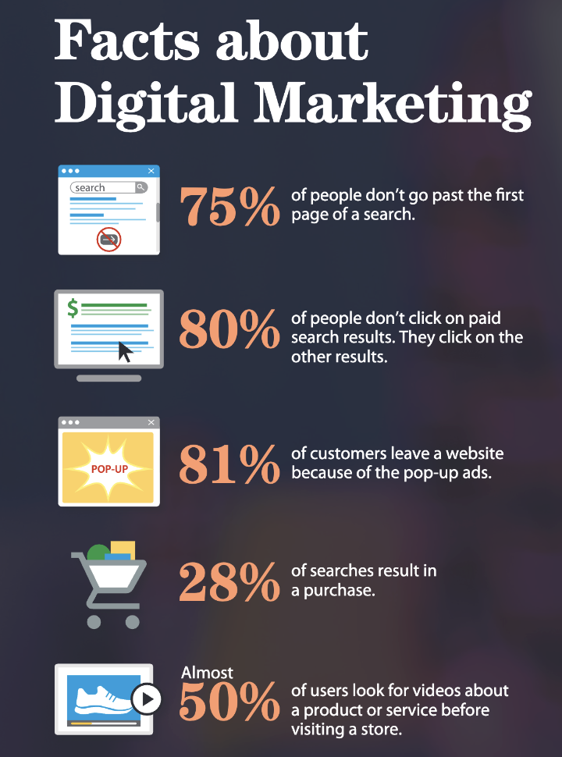
Explore the theme
Read the information (pp. 42-43).
Then discuss the questions.
What do you buy online?
Which of these things do you do when you are shopping online?
Does any of the information surprise you?

Slide 6

01
Vocabulary A

Slide 7

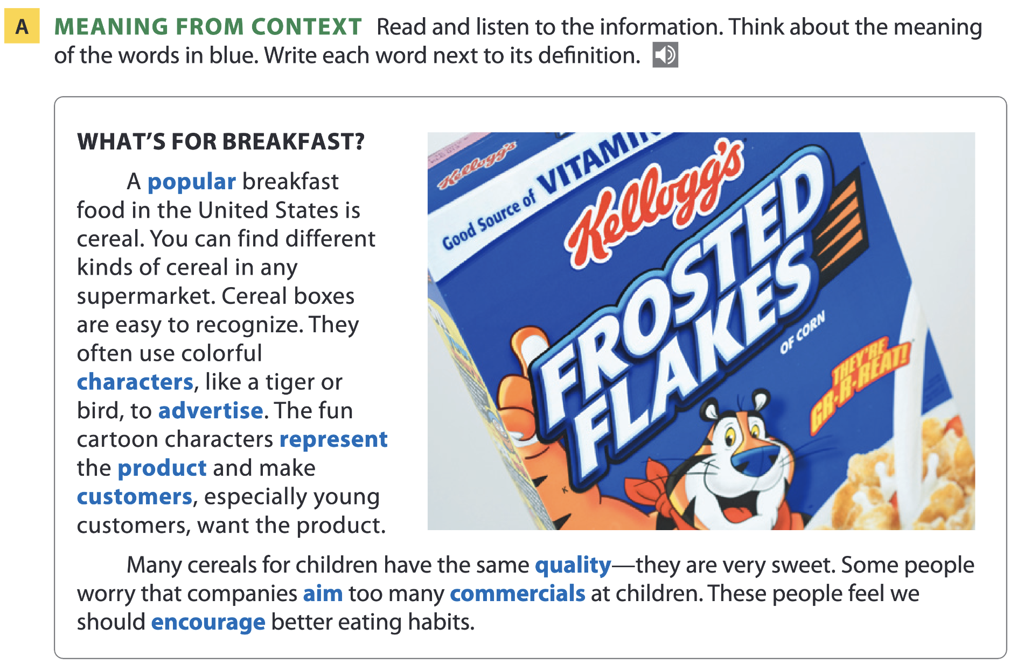
Page 44

Slide 8
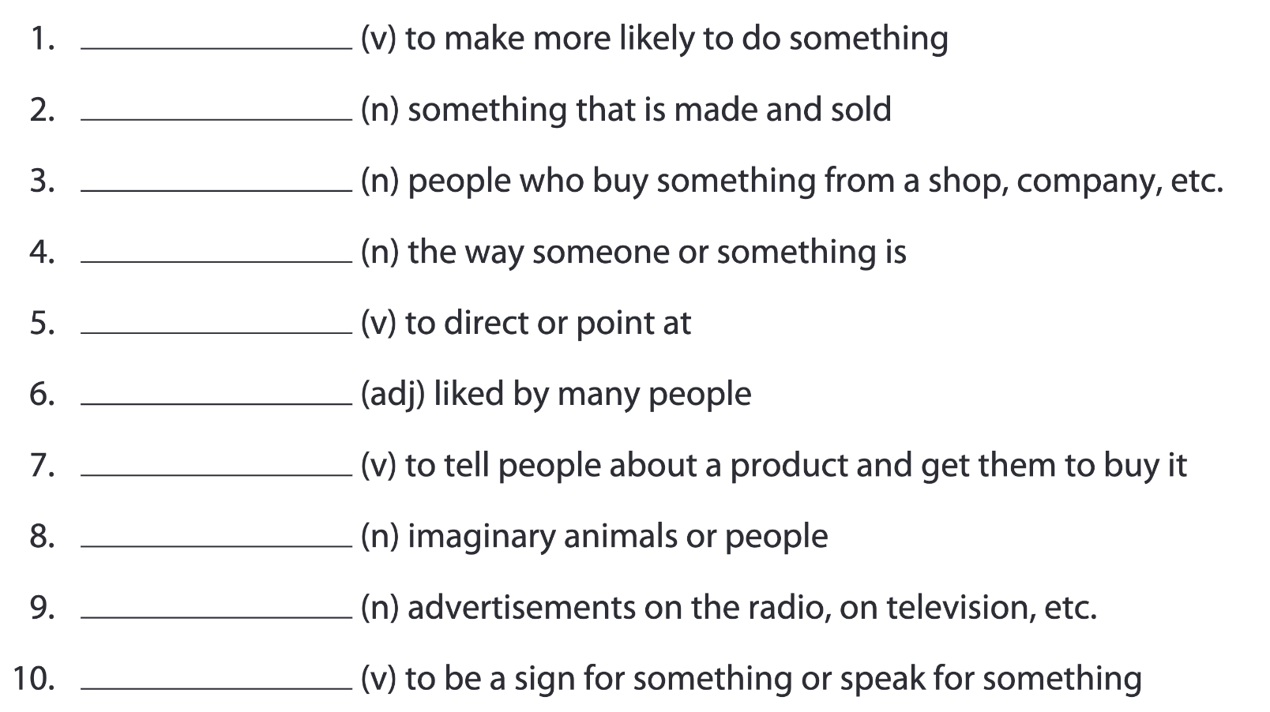
Page 44
encourage
product
customers
quality
aim
popular
advertise
characters
commercials
represent

Slide 9
Word list
encourage /ɪnˈkʌrɪdʒ/ (v): khuyến khích
product /ˈprɒdʌkt/ (n): sản phẩm
customer /ˈkʌstəmə/ (n): khách hàng
quality /ˈkwɒləti/ (n): chất lượng
aim /eɪm/ (v): nhắm đến
popular /ˈpɒpjələ(r)/ (adj): phổ biến
advertise /ˈædvətaɪz/ (v): quảng cáo
character /ˈkærəktə/ (n): nhân vật
commercial /kəˈmɜːʃəl/ (n): quảng cáo (trên TV, radio...)
represent /ˌreprɪˈzent/ (v): đại diện, thể hiện

Slide 10
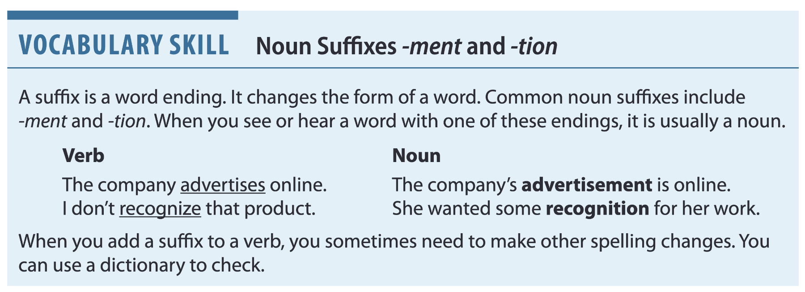
Page 45
Tip: Words ending in -tion are always stressed just before that suffix.
For example, in-for-ma-tion; pro-duc-tion; ac-tion; or-gan-i-za-tion.

Slide 11
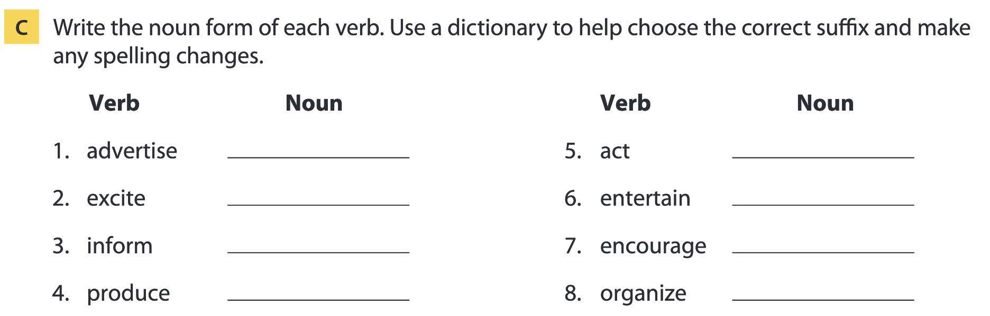
Page 45
advertisement
excitement
information
production
action
entertainment
encouragement
organization

Slide 12
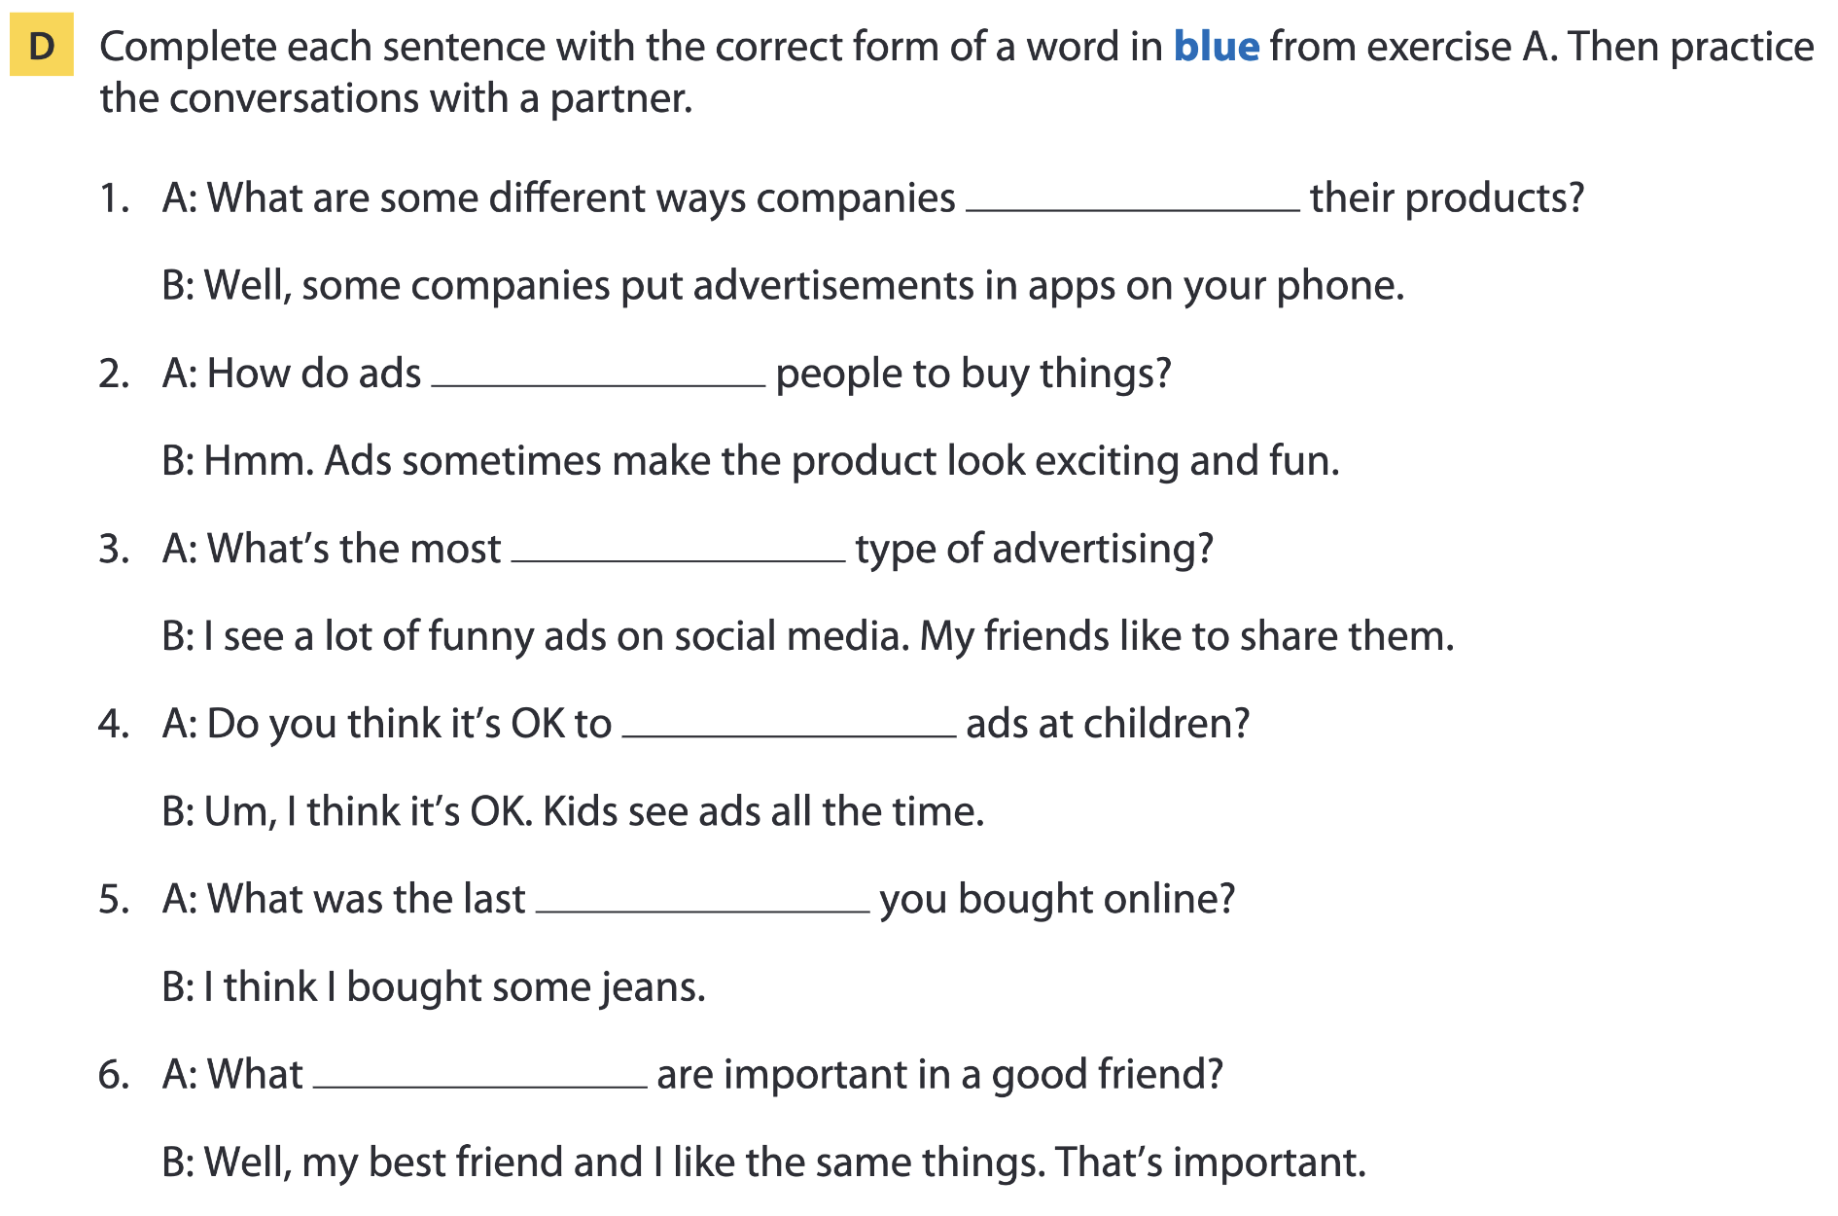
Page 45
advertise
encourage
popular
aim
product
qualities

Slide 13

02
Listening A

Slide 14
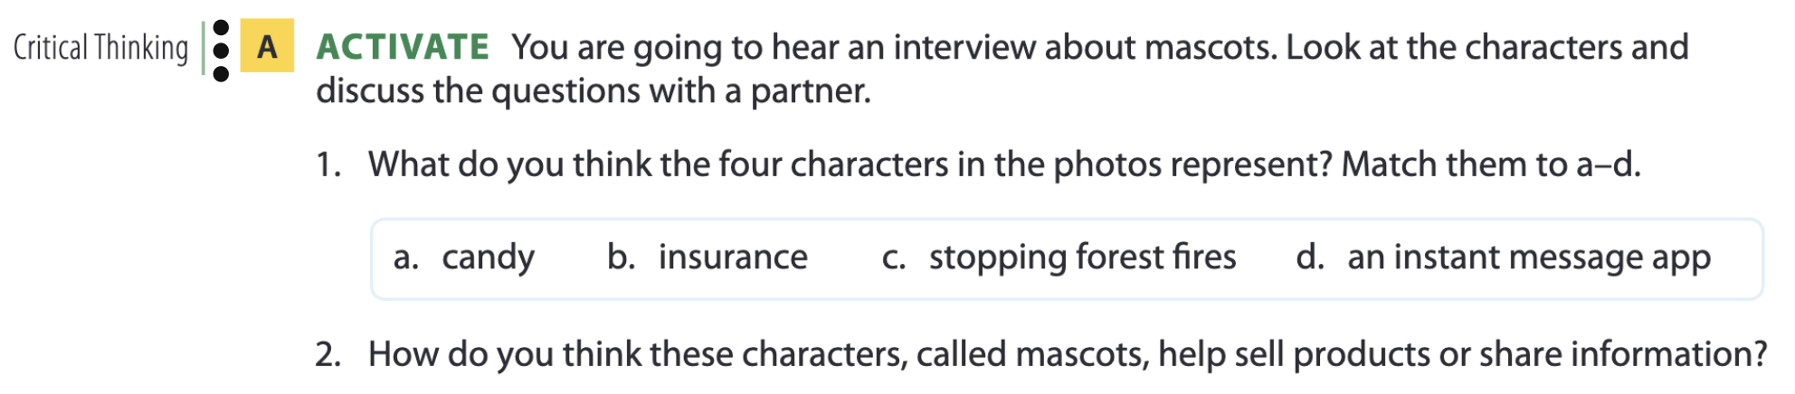
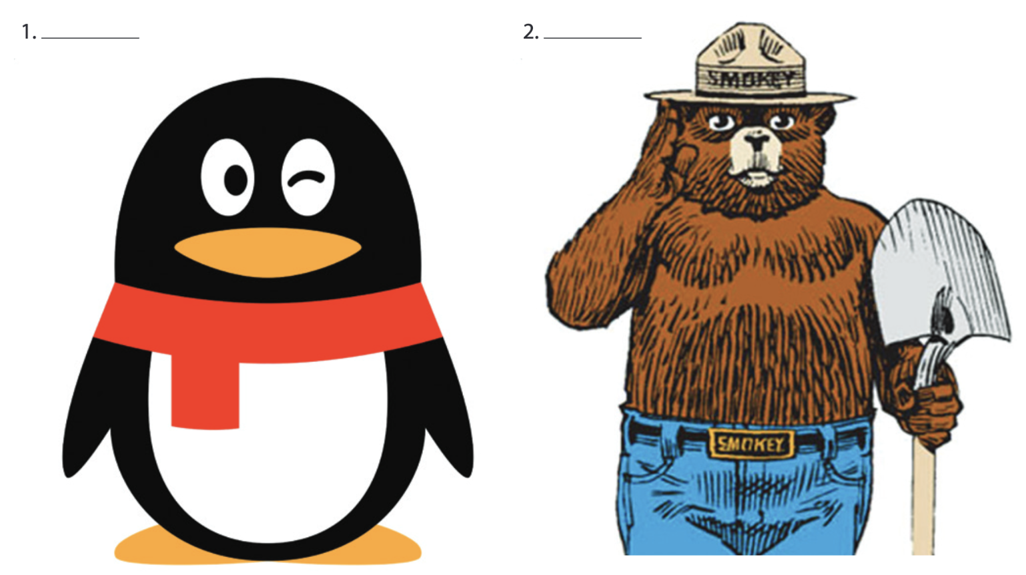
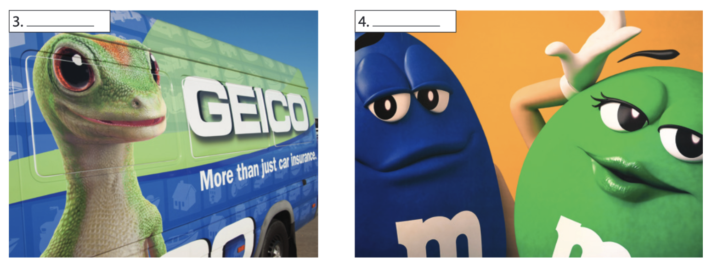
Mascots and marketing
Page 46
d
c
b
a

Slide 15
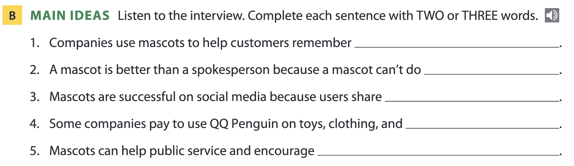
Page 47
their products
something bad
more information
products for schools
good work

Slide 16
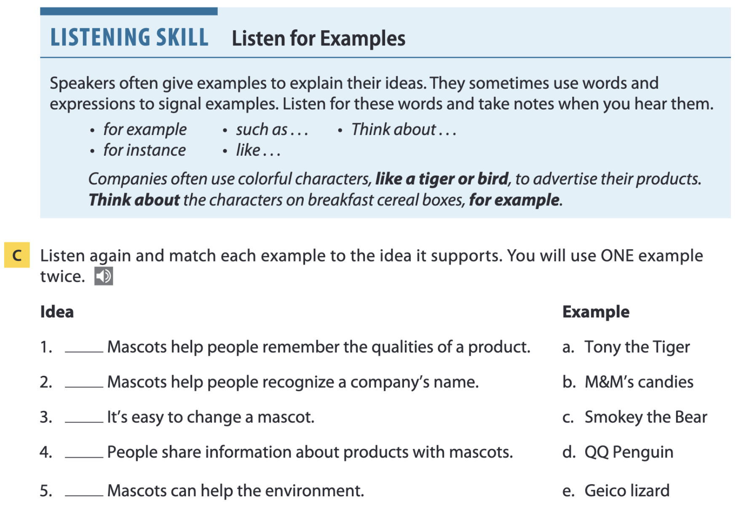
Page 47
for example and for instance may go at the beginning or end of a sentence.
Practice: Listen to an audio. What words or phrases from the box above can you hear?
Think about the advertising you see on social media. Influencers make content, like videos and posts, for companies that aim to sell products to their followers. For instance, they might recommend a product and provide discount codes to encourage their audience to buy it.

Slide 17
Page 47
b
e
b
a
c

Slide 18
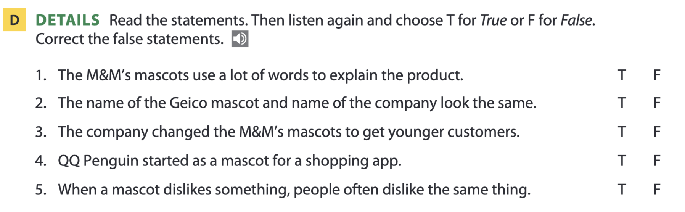
Page 47
no
sound
an instant message (app)

Slide 19
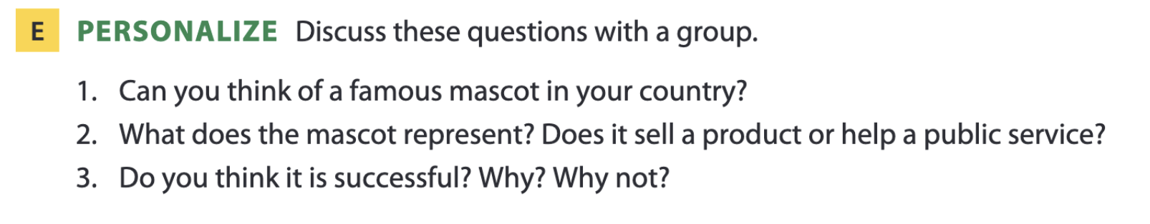
Page 47

Slide 20

03
Video watching

Slide 21
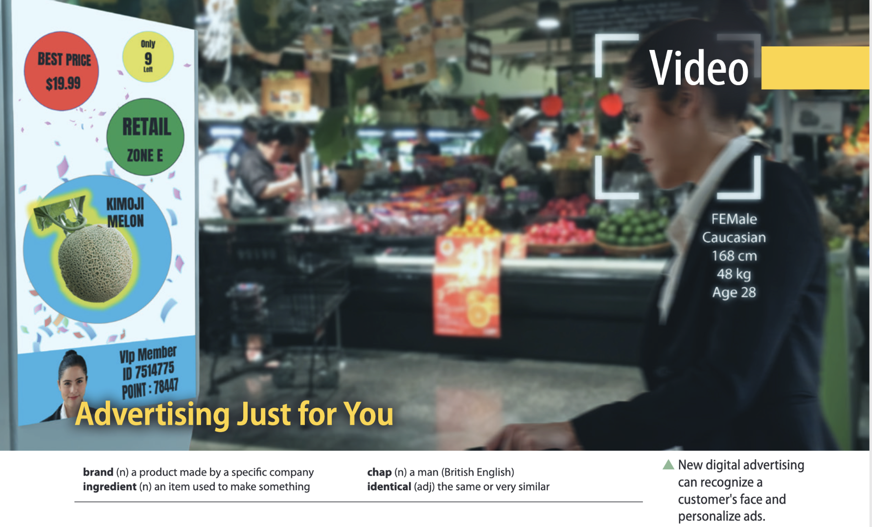
Page 51

Slide 22
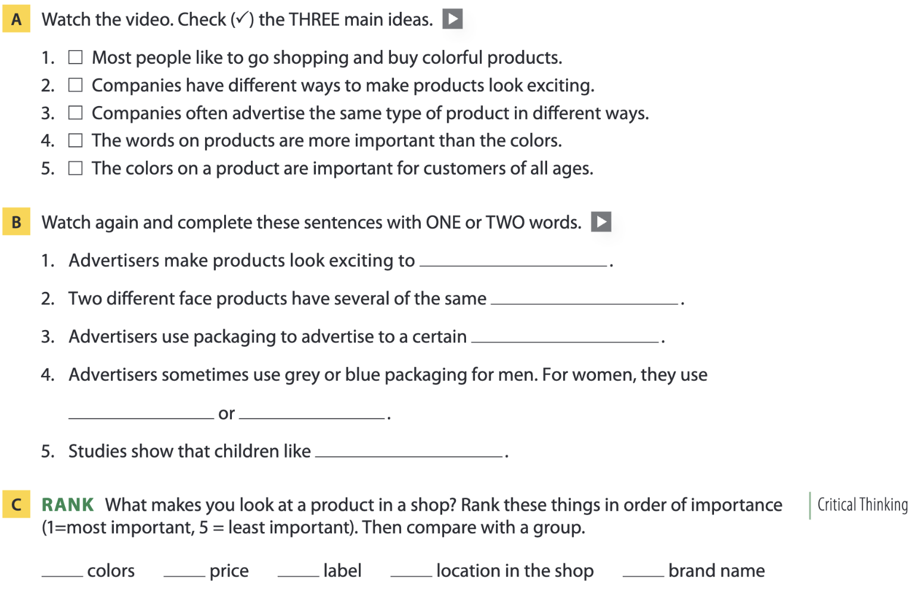

Page 51
customers
ingredients
audience
pink
white
bright colors

Slide 23
04
Vocabulary B

Slide 24
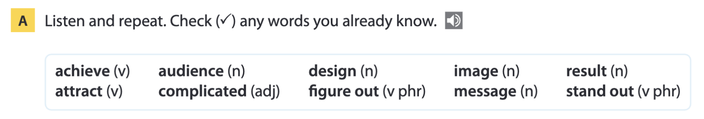
Page 52

Slide 25
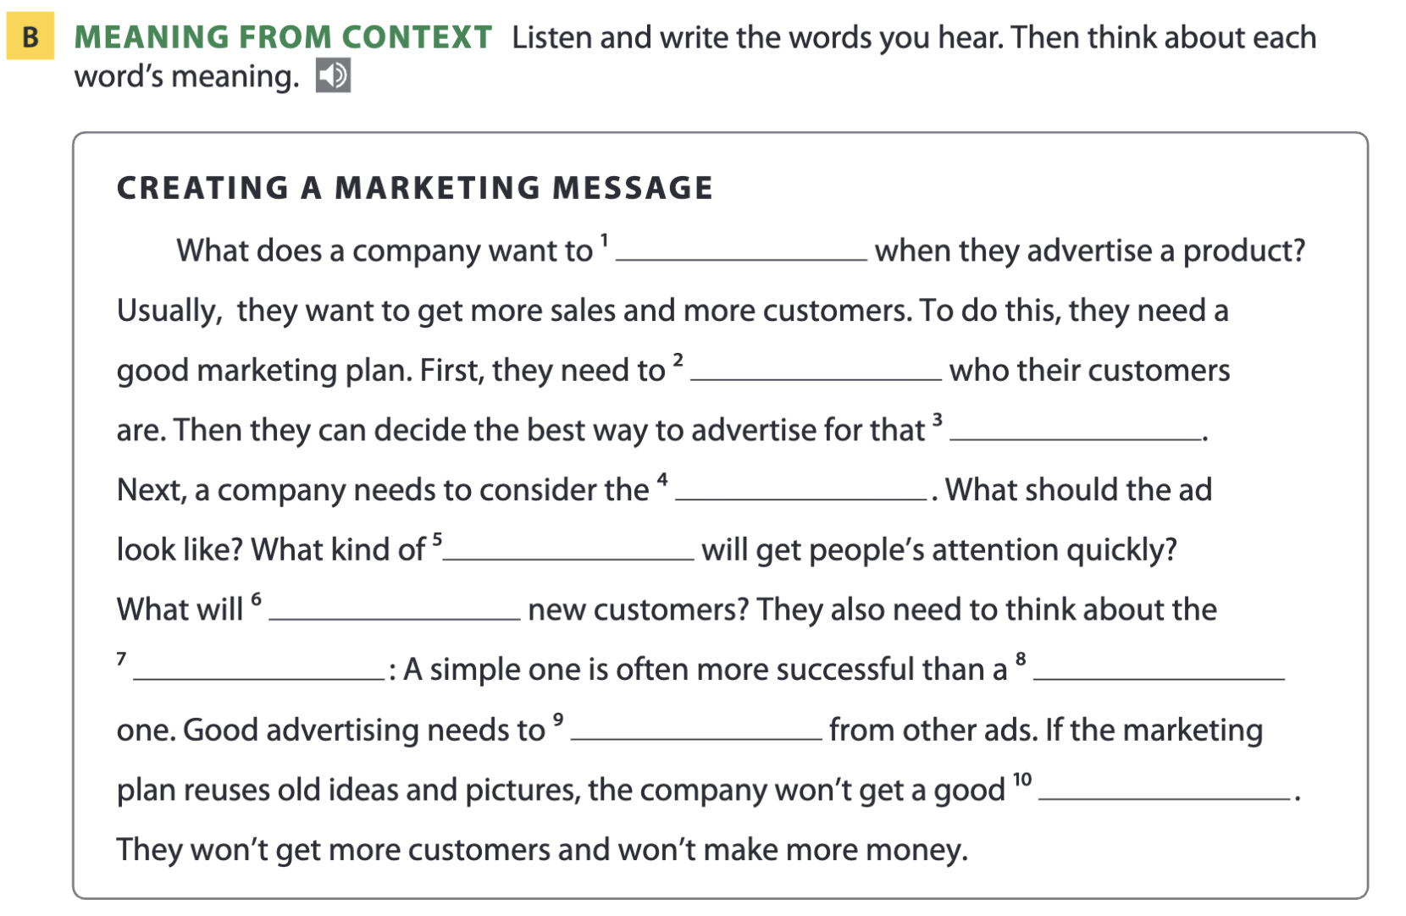
Page 52
achieve
figure out
audience
design
image
attract
message
complicated
stand out
result

Slide 26
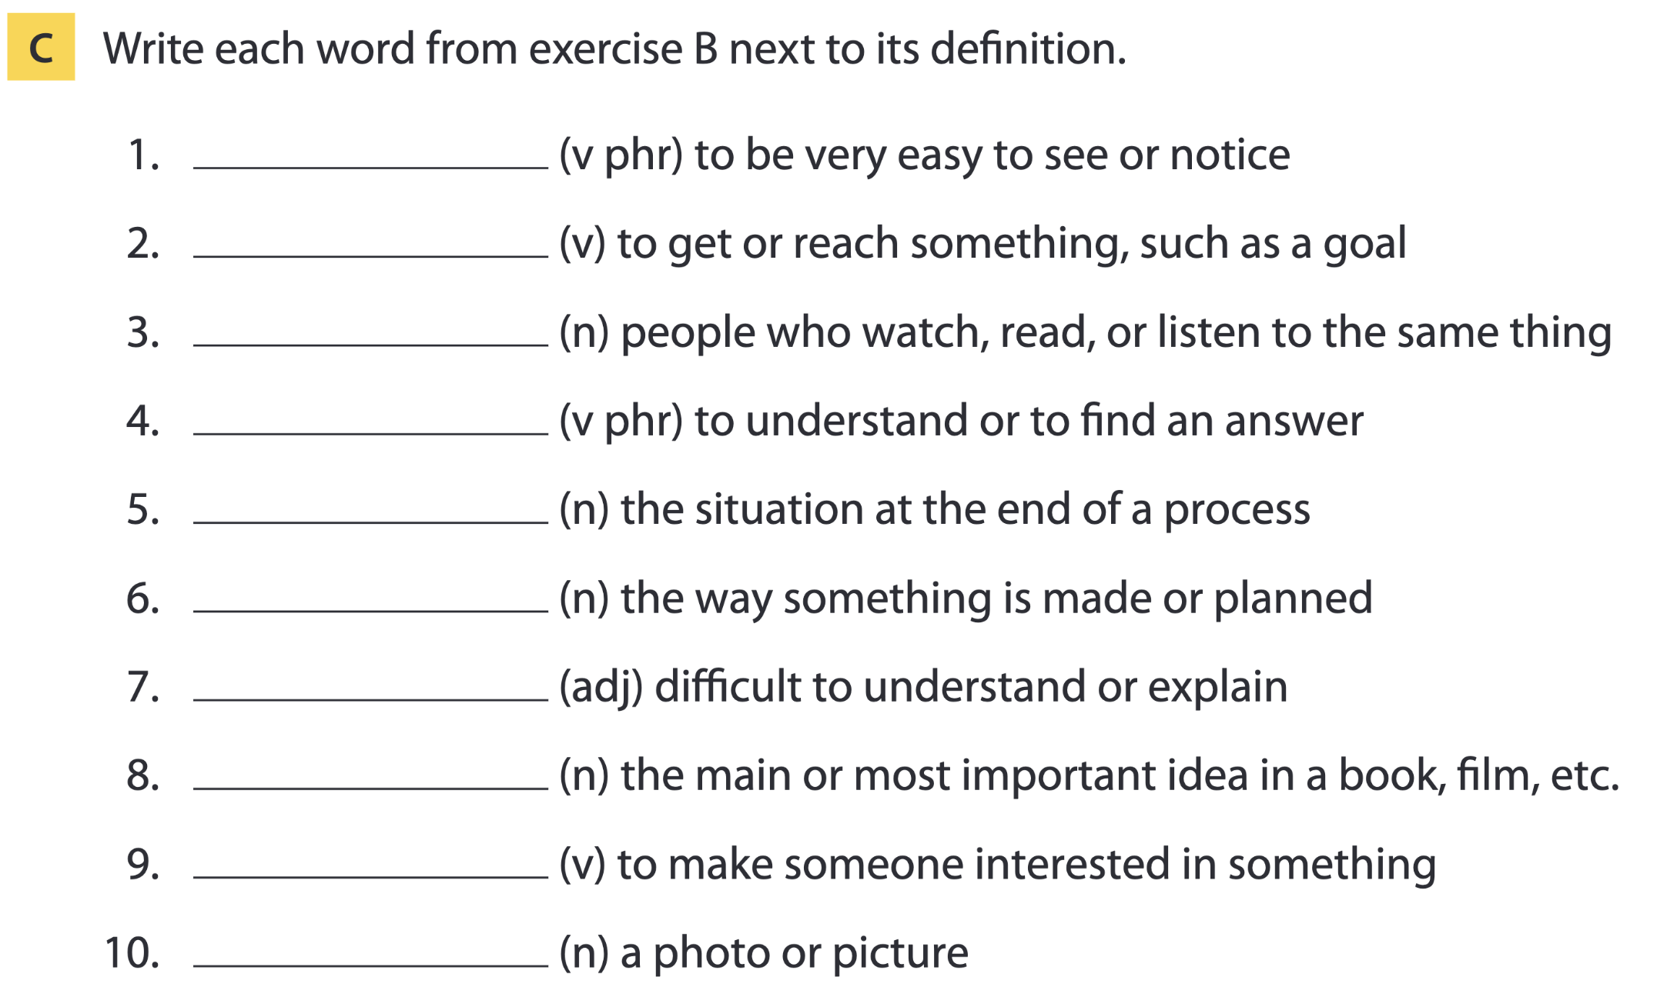
Page 52
stand out
achieve
audience
figure out
result
design
complicated
message
attract
image

Slide 27
Word list
stand out /stænd aʊt/ (phr. v): nổi bật
achieve /əˈtʃiːv/ (v): đạt được
audience /ˈɔːdiəns/ (n): khán giả
figure out /ˈfɪɡə(r) aʊt/ (phr. v): hiểu ra, tìm ra
result /rɪˈzʌlt/ (n): kết quả
design /dɪˈzaɪn/ (n): bản thiết kế (n)
complicated /ˈkɒmplɪkeɪtɪd/ (adj): phức tạp
message /ˈmesɪdʒ/ (n): thông điệp
attract /əˈtrækt/ (v): thu hút
image /ˈɪmɪdʒ/ (n): hình ảnh

Slide 28
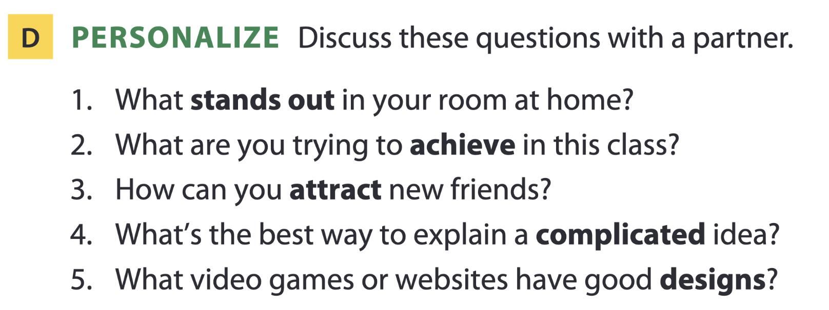
Page 53

Slide 29
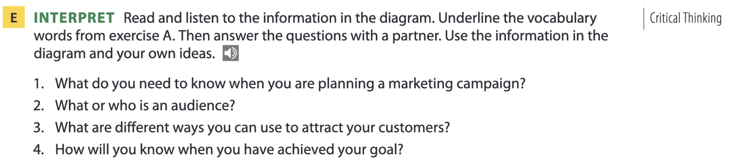
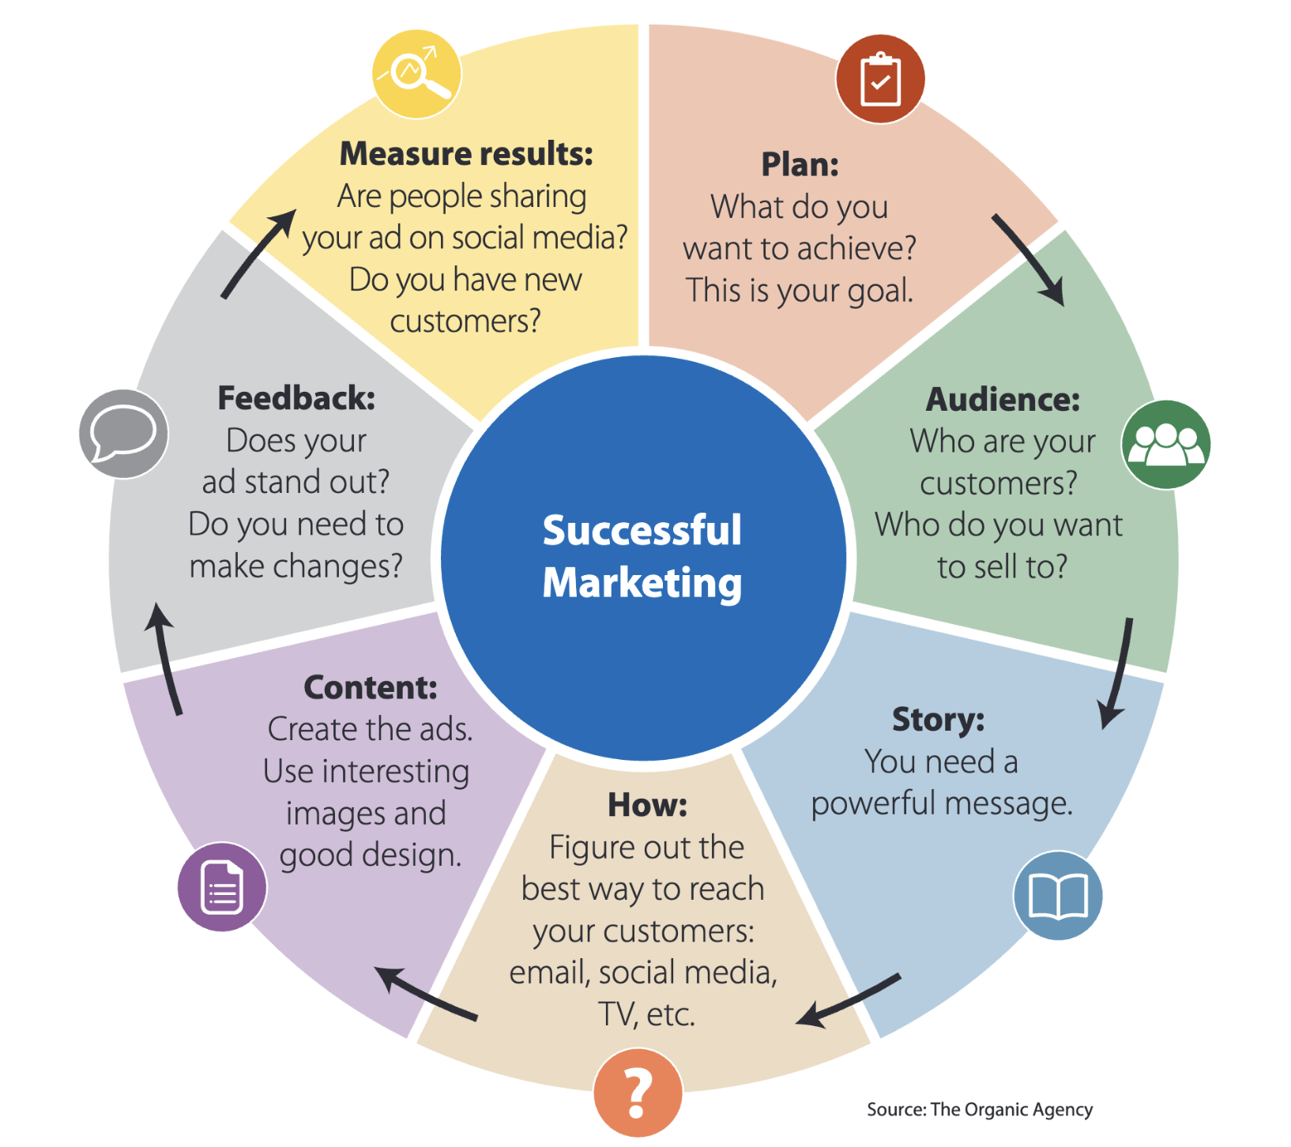
Page 53
achieve (v)
attract (v)
audience (n)
complicated (adj)
design (n)
figure out (v phr)
image (n)
message (n)
result (n)
stand out (v phr)

Slide 30
05
Listening B

Slide 31
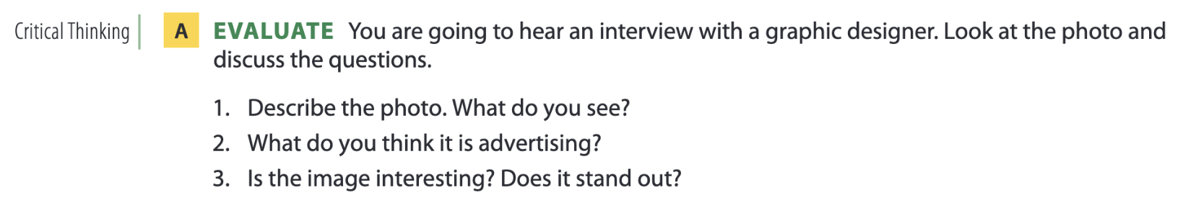
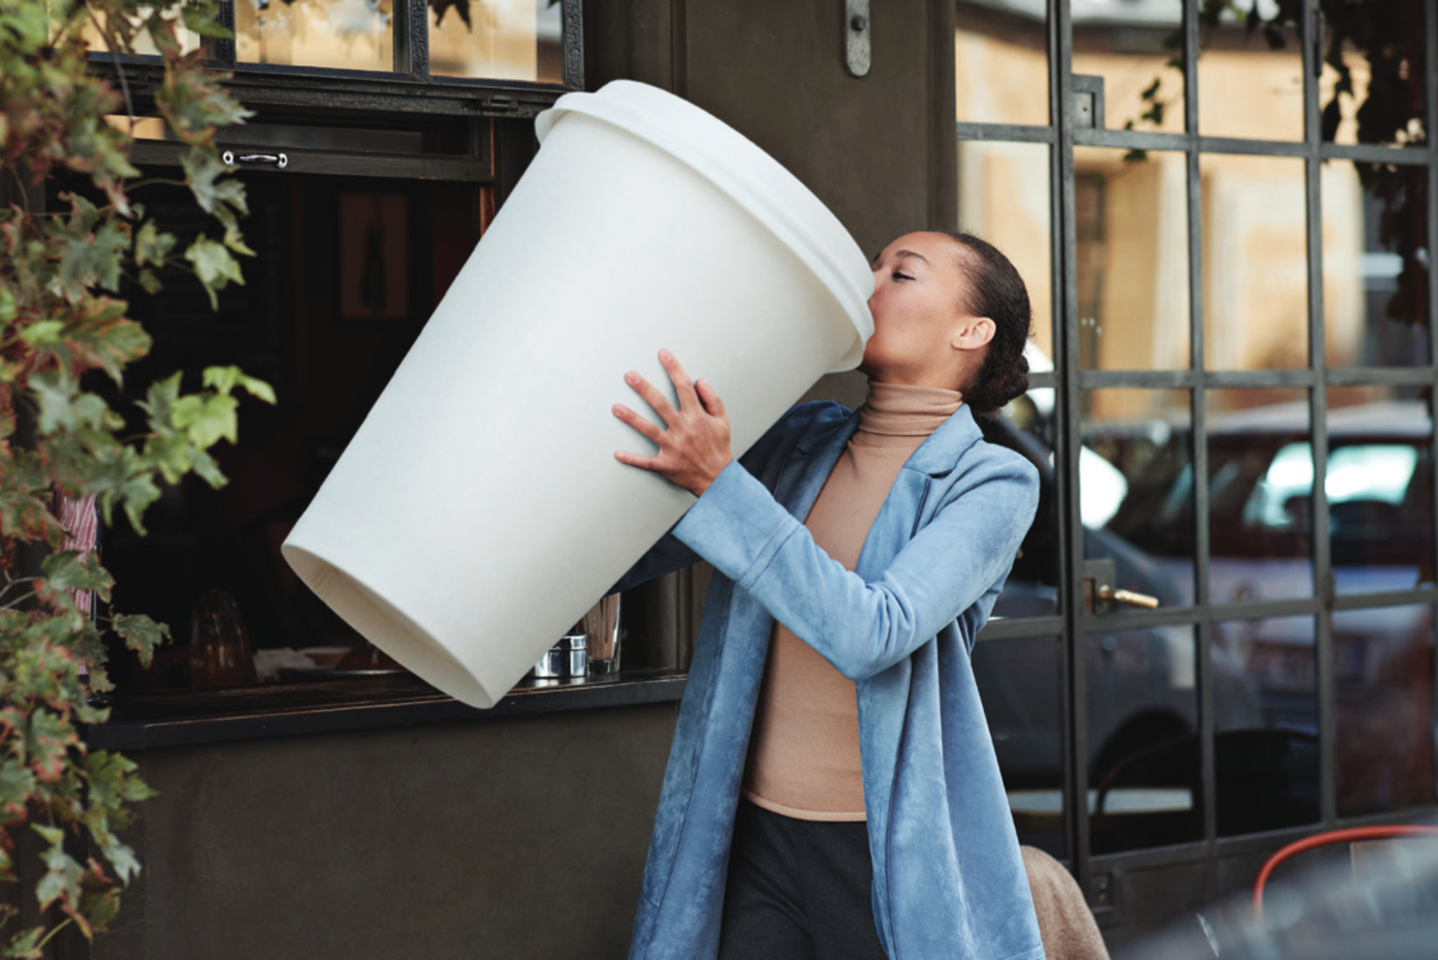
Graphic design
Page 54

Slide 32
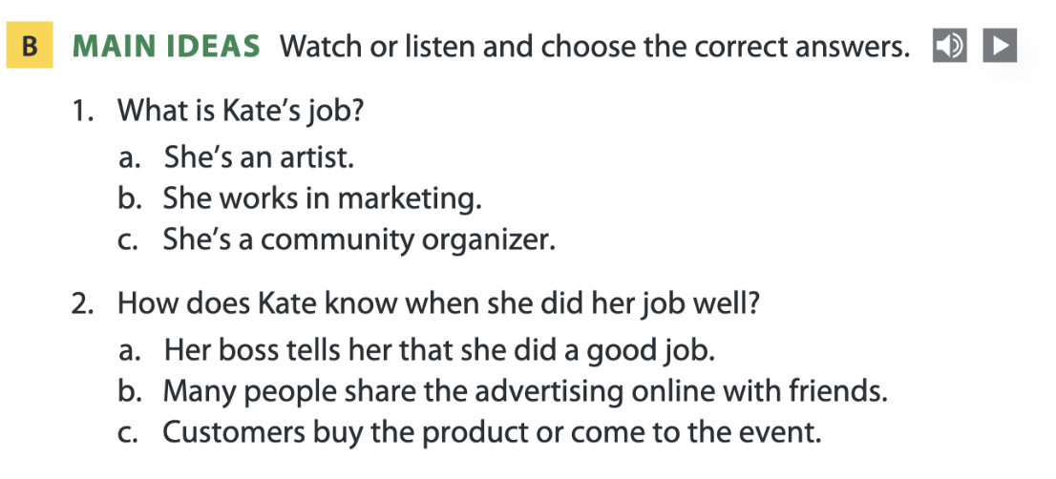
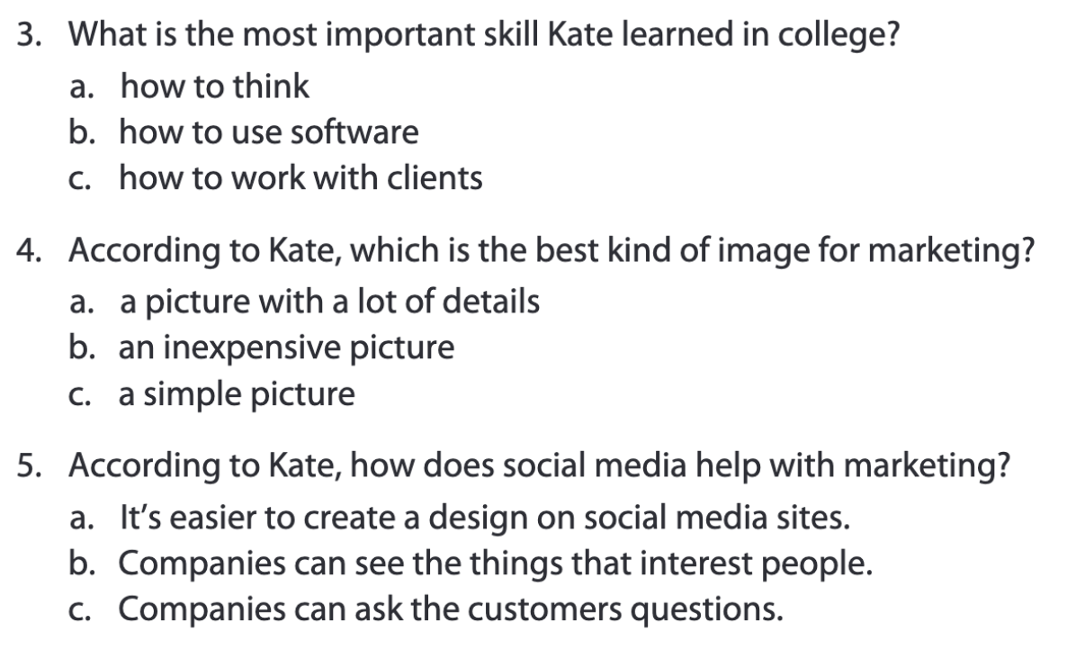
Pages 54-55

Slide 33
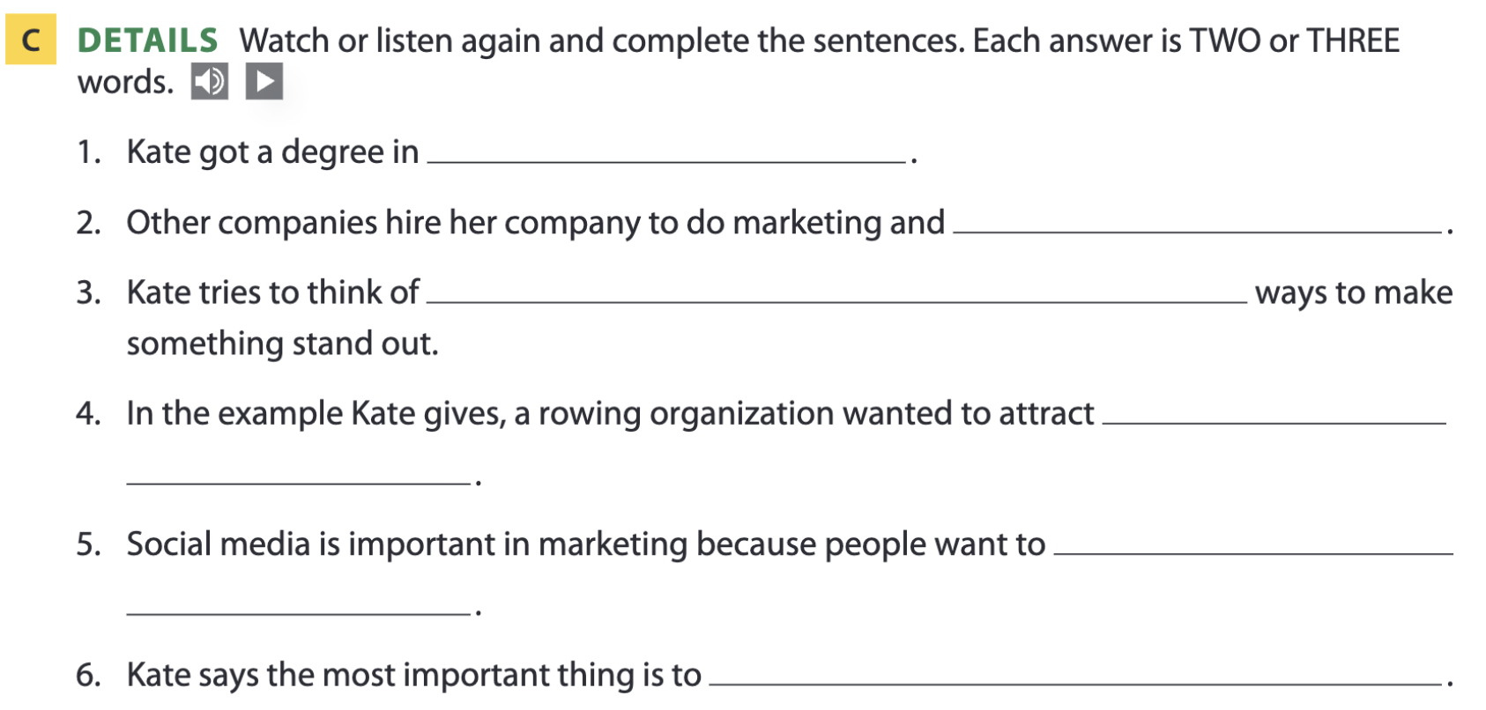
Page 55
graphic design
advertise products
new and unique
more people
share information
think creatively

Slide 34
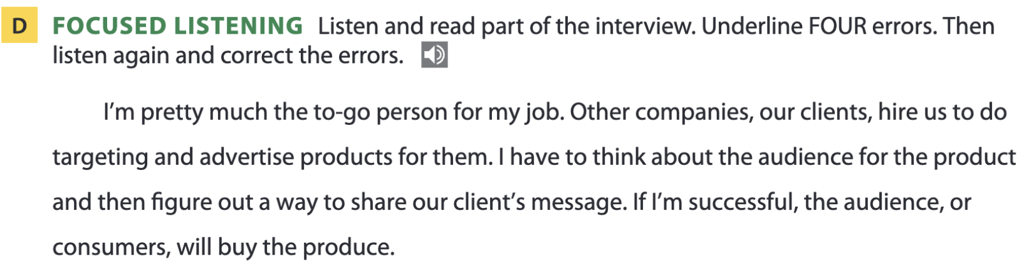
Page 55
go-to
marketing
customers
product

Slide 35
THANKS FOR YOUR ATTENTION!

